Slide 1
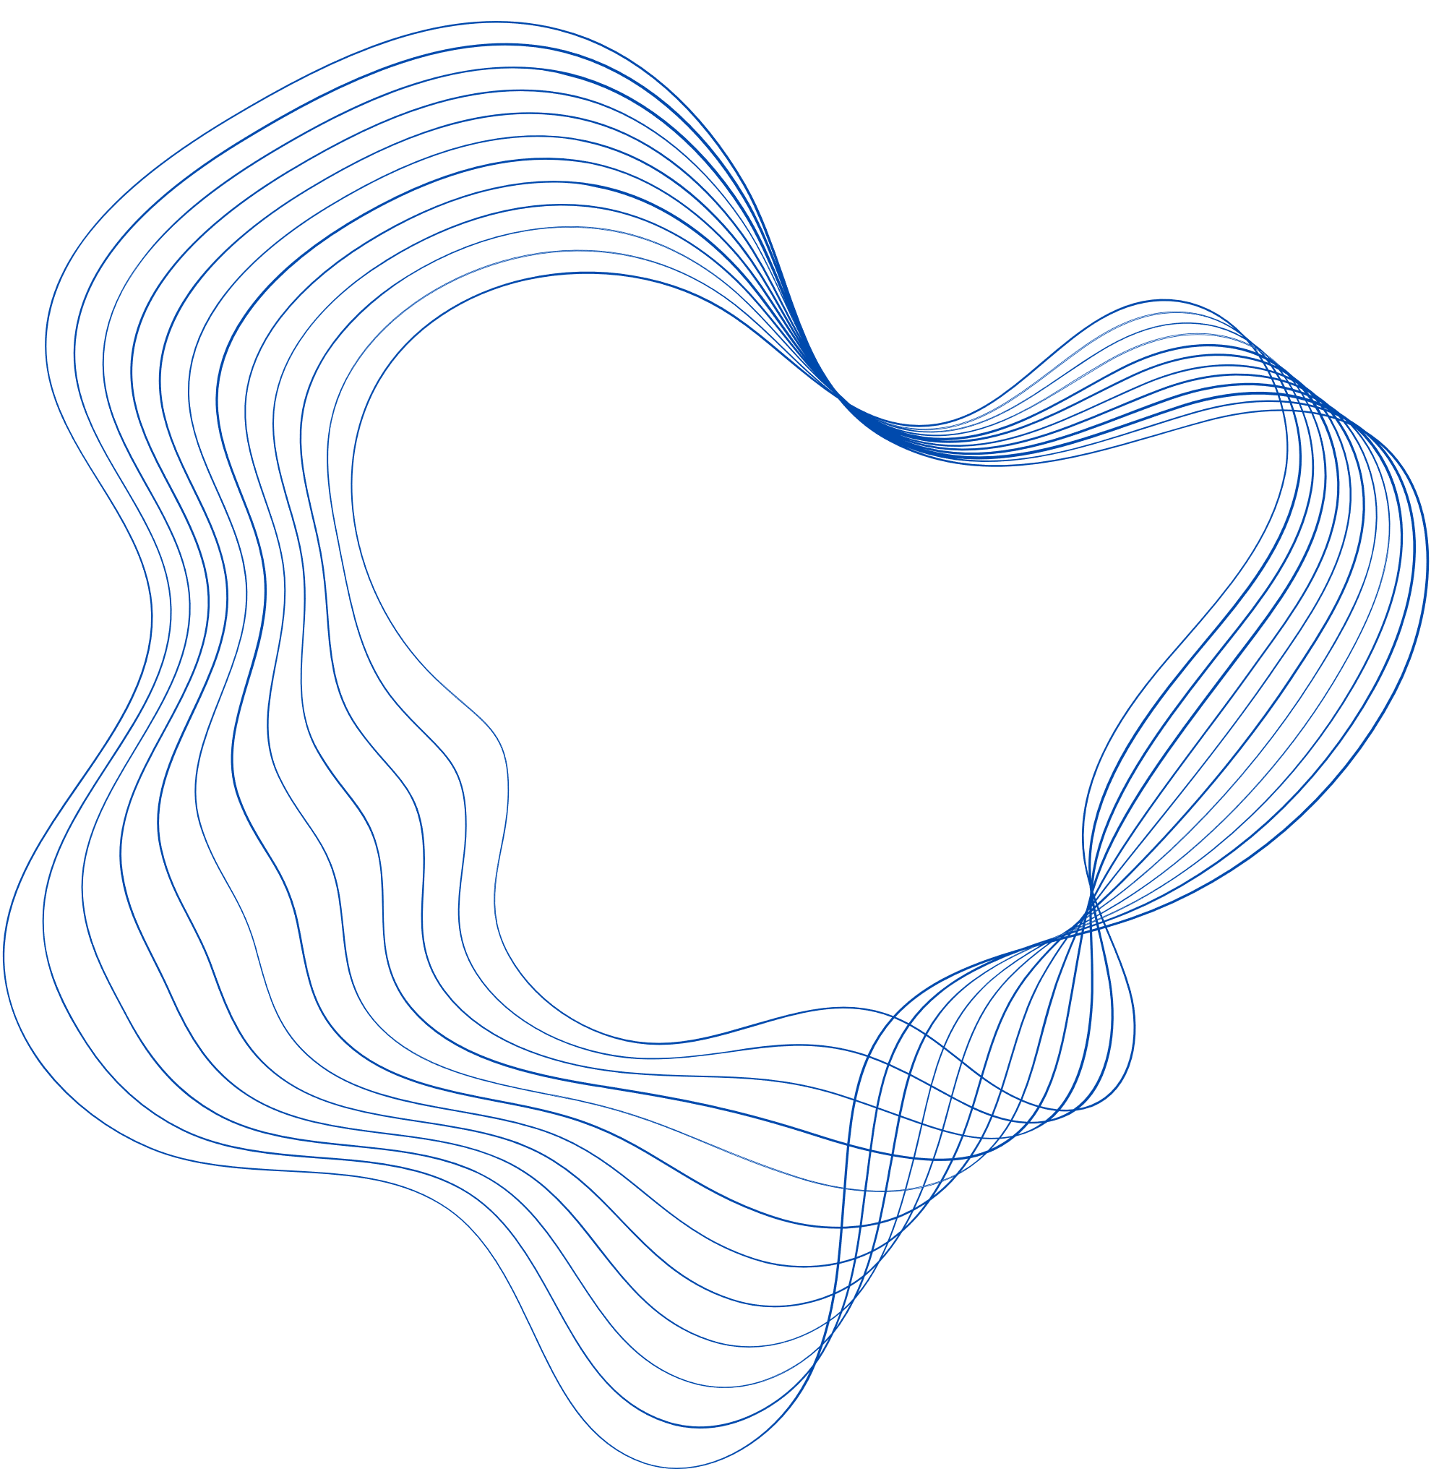

Evaluation of edges readiness using masked graph autoencoders - MaskGAE
Capstone Project Phase B
Students:
Chen Hanzin
Gilad Segal
Supervisors:
Dr. Renata Avros
Prof. Zeev Volkovich

Slide 2


TABLE OF CONTENTS
01
INTRODUCTION
02
STRUCTURE
03
MODEL FLOW
04
MODEL INNOVATION
05
IMPLEMENTATION
06
CHALLENGES
07
RESULTS

Slide 3
01
INTRODUCTION

Slide 4

Introduction
The project focuses on improving Graph Autoencoders (GAEs), a type of machine learning model that learns from graph data.
GAEs work by simplifying complex graphs into low-dimensional representations (compressed versions), and then trying to rebuild the original graphs as accurately as possible.
However, traditional GAEs sometimes concentrate too much on the direct connections between closely linked nodes, which can lead to missing the overall structure of the graph.

Slide 5
02
STRUCTURE

Slide 6


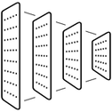

STRUCTURE
Masking Strategy
Encoder-Decoder Framework
The system hides some edges in the graph on purpose. This forces the encoder to learn more useful patterns, without relying too much on direct connections.
The encoder (GCN) takes the masked graph and turns it into a simple version of each node. The decoder then tries to rebuild the original graph, including the hidden edges, from this simplified version.
Graph Convolutional Network
Learning Objective
The encoder uses a GCN, which is a popular method for working with graph data. It gathers information from a node’s nearby neighbors, creating a simpler version of each node that still keeps key local details.
The system is built to understand both the close connections between nodes and the overall structure of the graph. This helps it focus not just on nearby nodes but also on how everything in the graph is connected.

Slide 7
03
MODEL FLOW

Slide 8
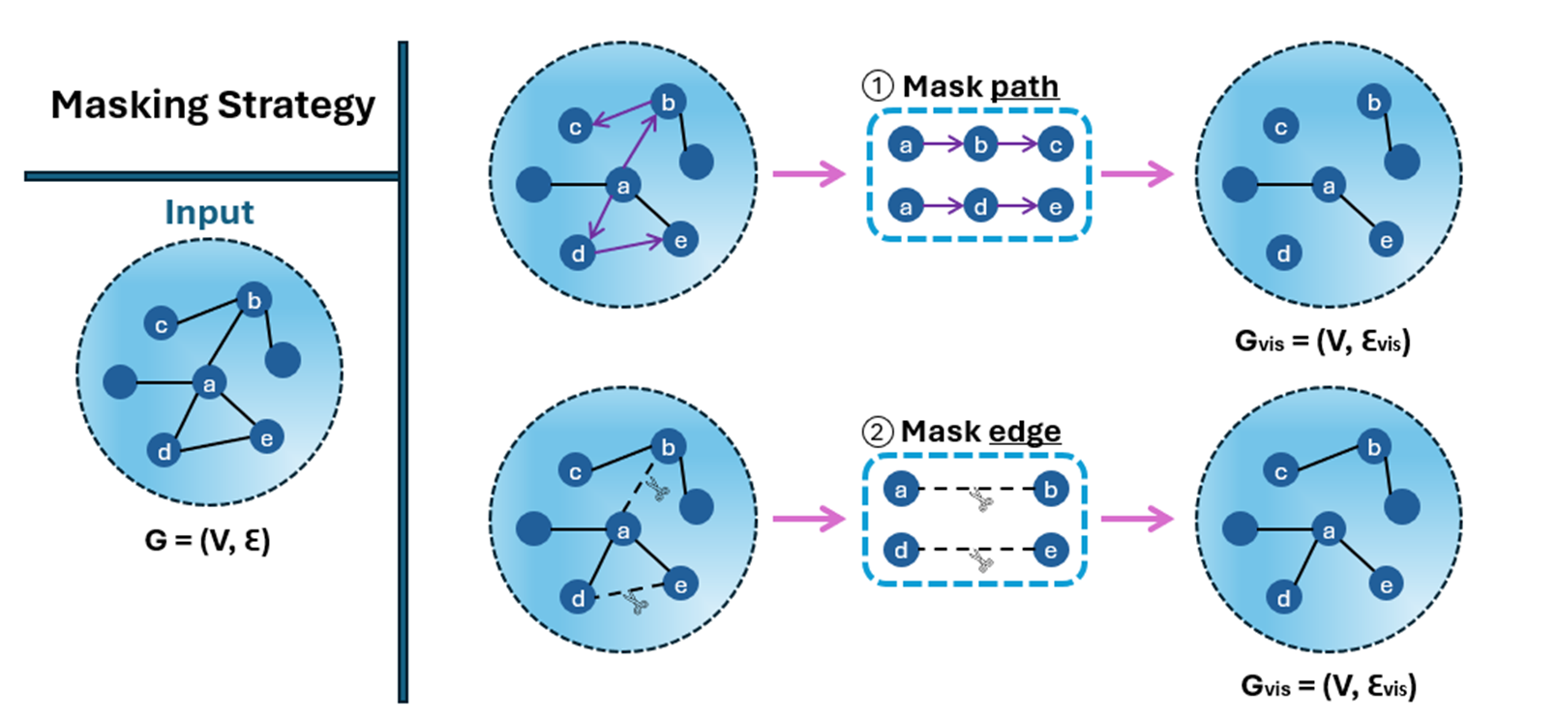
MaskGAE Model – Masking Strategy

Slide 9
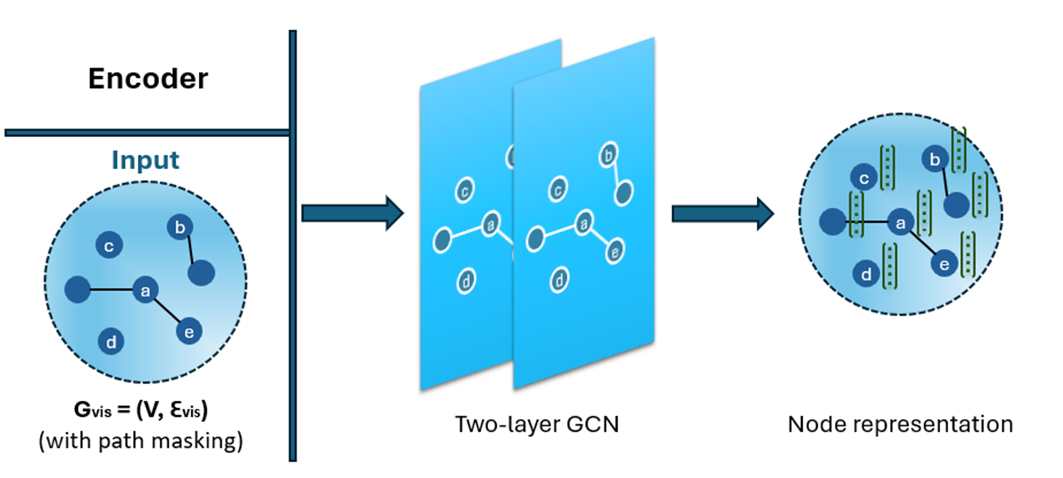
MaskGAE Model – Encoder

Slide 10
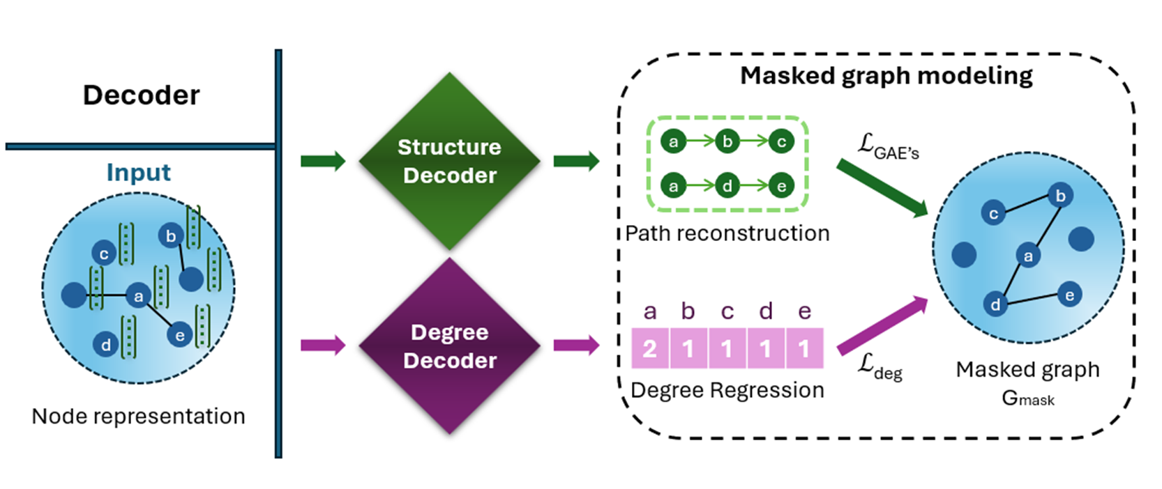
MaskGAE Model – Decoder

Slide 11
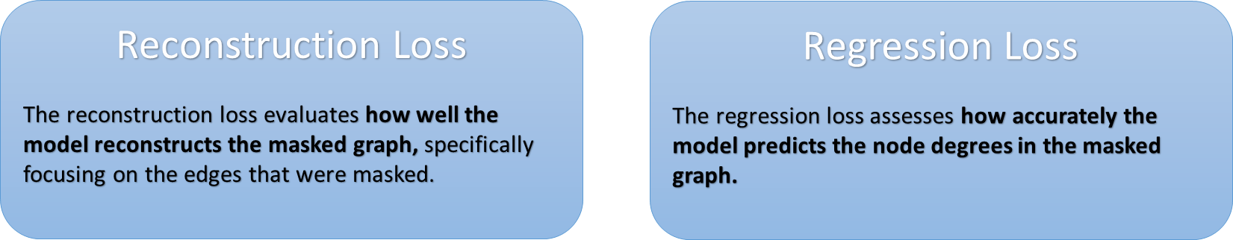
MaskGAE Model – Learning Objective

Slide 12
04
MODEL INNOVATION

Slide 13
The innovation
Redundancy Reduction: As part of the learning process, the system also aims to reduce redundancy between paired subgraphs. This is achieved through the masking strategies, which help in minimizing the overlap between subgraphs and thus reducing redundant information.
Mutual Information Optimization: The model is designed to optimize the mutual information between different views of the graph (represented by subgraphs) to ensure that the learned representations are both relevant and non-redundant for downstream tasks.

Slide 14
05
IMPLEMENTATION

Slide 15




Tools For Implemetation
+
VS Code with Git
Cloud Computing
Python Libraries
Utilized Visual Studio Code with Git integration for code management, ensuring flexibility and version control.
Google Colab cloud-based IDE allows us to write and execute Python code in a web browser, providing easy access to powerful computational resources such as GPUs and TPUs.
The MaskGAE model used NumPy for data manipulation, PyTorch for model development, and torch-geometric for handling graph-based data.
SciPy supported mathematical operations, while CUDA and CUDNN provided GPU acceleration for efficient model training.
Notes:
There are 3 main tools used throughout the reaserch process that helped us:
Visual Studio Code with GIT:
Utilizing visual studio code with git integration for code management –
ensuring flexibility and consistency across different machines.
Cloud computing:
Software and Libraries

Slide 16
Research Code
train_linkpred.py: script used for training the MaskGAE model, focusing on link prediction tasks. They allowed for the adjustment of key parameters (batch size, masking strategy, dropout rates and etc).
train_nodeclas.py: This script was dedicated to node classification tasks, another key area of performance evaluation for the MaskGAE model. It also supported pretext training for link prediction​.
model.py: Contained the core MaskGAE model architecture, including the encoder and decoder components, leveraging GNN layers and implementing the masking strategies for to the research.

Slide 17
Research Code
mask.py: Managed the masking strategies such as MaskEdge and MaskPath, which were key innovations in the MaskGAE model, helping to selectively mask subgraphs and edges.
loss.py: Defined the various loss functions used for model training, including custom loss functions critical for evaluating the model's performance during graph reconstruction​.
utils.py: Provided utility functions for setting seeds, loading datasets, and formatting results, ensuring consistency and ease of use across different scripts.

Slide 18
06
CHALLENGES

Slide 19
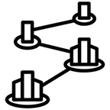


CHALLENGES
Masking Strategy Complexity
Model Scalability
Balancing the amount of information hidden through masking was challenging, requiring careful tuning to avoid losing key graph structures. We experimented with edge-wise and path-wise masking proportions to ensure the model learned useful features.
Scaling the model to work with larger graphs is still a big challenge. Training on large graph datasets takes a lot of time and resources, and even with some improvements, it's something we continue to work on.
Tuning the MaskGAE Model
Evaluation Metrics
Adjusting the MaskGAE model took several tries to make sure the encoder and decoder were learning useful patterns without overfitting. This meant changing hyperparameters often and using a lot of computational power.
Choosing the right metrics to evaluate the model's performance is difficult because graph structures are complex. It's hard to balance between accurate reconstruction and keeping important graph features intact.

Slide 20
07
RESULTS

Slide 21
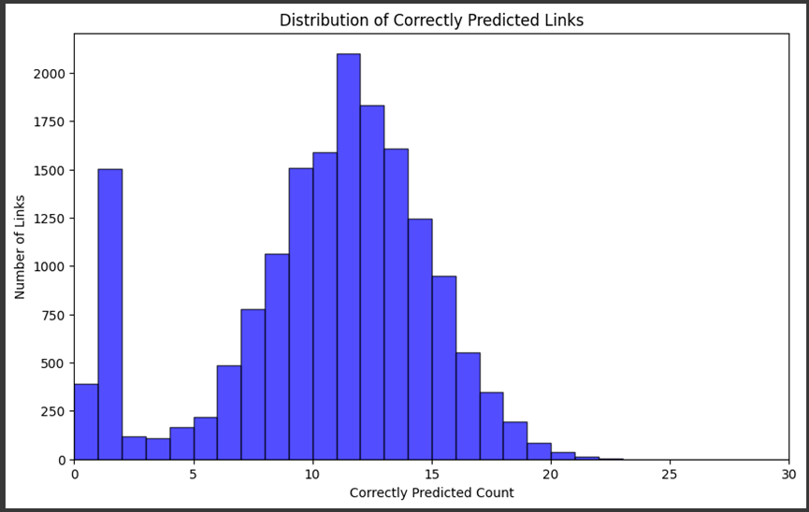
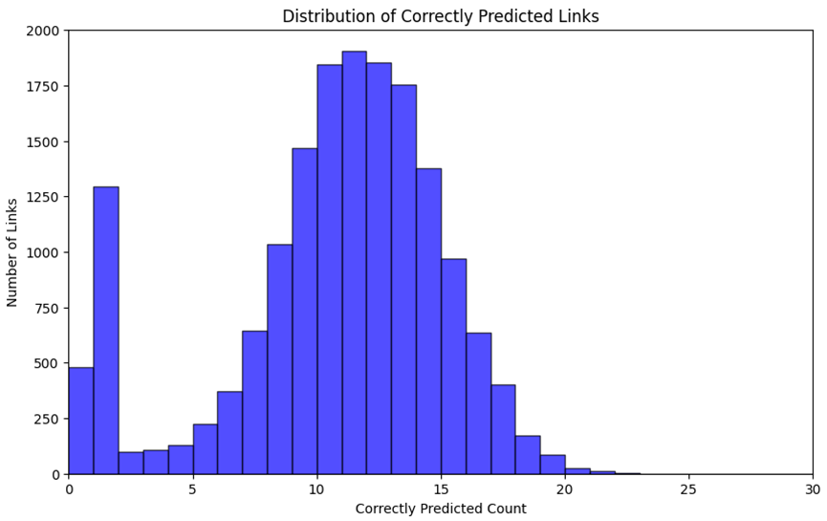
Example Train
P=0.3
P=0.5

Slide 22
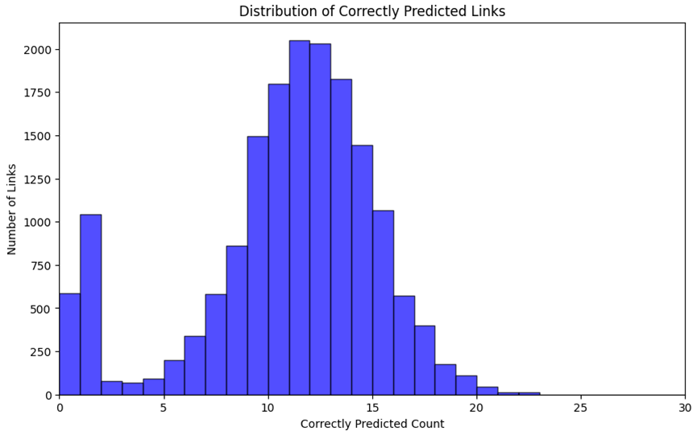
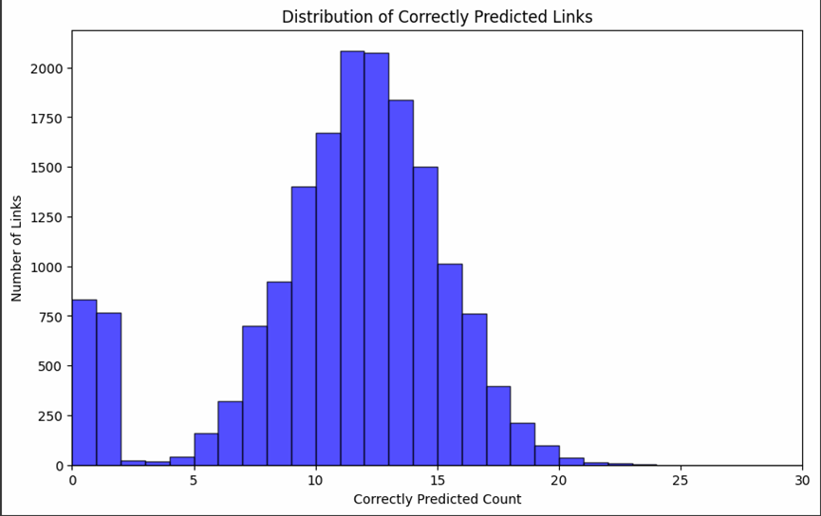
Example Train
P=0.7 (default)
P=0.9

Slide 23

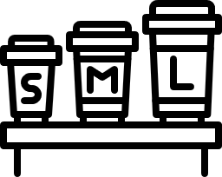

GENERAL CONCLUSION
Impact of Masking Strategies
Both the Path and Edge Masking Strategies performed well in the link prediction task, with the Edge showing a slight advantage. Overall, the differences remain minimal, as reflected in the similar AUC and AP scores.
Masking Ratio (P)
At p = 0.3, the model struggled with links prediction (higher number of 0-1). However, as the masking ratio increased to p = 0.7 and p = 0.9, the model showed more balanced predictions, indicating a better balance between providing information and challenging the model.
Test Set Size
Larger test sets (50%) led to more balanced distribution of correct predictions, but also an increase in links predicted 0-1 times.
In contrast, smaller test sets (30%) led to fewer poorly predicted links. Larger test sets seem to help the model to identify better, due to the increased diversity of links.
Analysis of Poorly Predicted Links
Across all experiments, the spike in links predicted 0-1 times was a consistent observation. These links likely correspond to sparsely connected nodes or those in structurally complex regions, where the model struggled to establish strong predictive patterns.
Notes:
To dive deeper into the causes of this skewness:
Analyze the Hard-to-Predict Links (those with 0-5 correct predictions):
Investigate which links are difficult to predict. Are these links between certain types of papers or node classes? Are they more isolated in the graph or weakly connected to other nodes?
Examine the Node and Edge Attributes:
Look at the node features associated with the harder-to-predict edges. Do these nodes have unique or rare attributes? Are the features insufficient to help predict the link?
Inspect Graph Structure:
Check if the links that are well-predicted come from dense clusters of nodes (e.g., citations within similar research fields) and if the hard-to-predict links come from sparse or noisy parts of the graph.
כלומר, קשתות שזוהו- האם הצמתים שיוצרים אותם מחוברים להרבה צמתים אחרים ולכן נמצאים באותו קלאסטר והפוך עבור קשתות שהיה קשה לזהות.
Adjust Model or Graph Augmentation:
Consider applying different graph augmentations, such as using higher-order connectivity (more hops) in your model, to capture more global patterns in the graph. This might help with predicting links that are not well-connected locally but are part of global patterns.

Slide 24


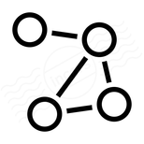

FURTHER INVESTIGATION
Analyze the 0-1 correct predictions links
Investigate which links are difficult to predict and which papers or classes they represent. investigate their amount of connections (weakly connected or strongly connected).
Node and Edge Attributes
Examine the node features associated with the harder-to-predict edges in comparison to more well- predicted edges.
Inspect Graph Structure
Check if the links that are well-predicted come from dense clusters of nodes and if the hard-to-predict links come from sparse or noisy parts of the graph.
Adjust Model Parameters
Experimenting with different model parameters, such as threshold for prediction and P ratio for masking.

Slide 25
Thanks for listening!

